Slide 1
Chapter 10 Approximate Inference

Slide 2
Contents
10.1 Variational Inference
10.2 Variational Mixture of Gaussians
10.3 Variational Linear Regression
10.4 Exponential Family Distributions
10.5 Local Variational Methods
10.6 Variational Logistic Regression
10.7 Expectation Propagation

Slide 3



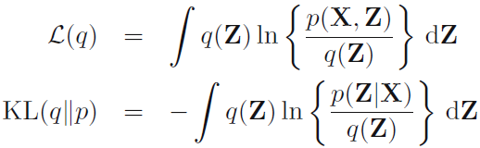

10.1 Variational Inference
A central task in the application of probabilistic models is the evaluation of the posterior distribution $p(Z|X)$ of the latent variables $Z$ given the observed (visible) data variables $X$, and the evaluation of expectations computed with respect to this distribution.
Suppose we have a fully Bayesian model in which all parameters are given prior distributions.
$N$ independent, identically distributed data
Observed variables:
Latent variables and parameters:
Our goal is to find an approximation for the posterior distribution $p(Z|X)$ as well as for the model evidence $p(X)$. We can decompose the log marginal probability using

Slide 4


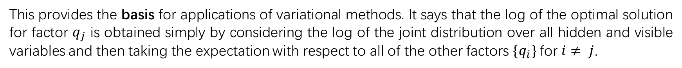
10.1 Variational Inference
Factorized distributions
Suppose we partition the elements of $Z$ into disjoint groups
The optimal solution
(10.9)
This provides the basis for applications of variational methods. It says that the log of the optimal solution for factor $q_{j}$ is obtained simply by considering the log of the joint distribution over all hidden and visible variables and then taking the expectation with respect to all of the other factors $\{q_{i}\}$for $i≠ j$.

Slide 5



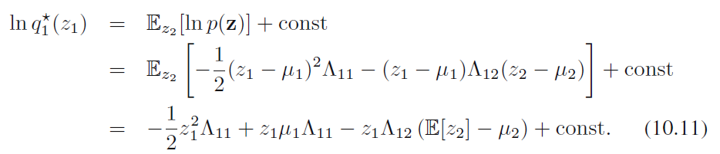
10.1 Variational Inference
Properties of factorized approximations
Our approach to variational inference is based on a factorized approximation to the true posterior distribution. Here, we consider a problem of approximating a general distribution by a factorized distribution.
Approximate a Gaussian distribution using a factorized Gaussian of the form $q\left(z\right)=q_{1}\left(z_{1}\right)q_{2}(z_{2})$

Slide 6
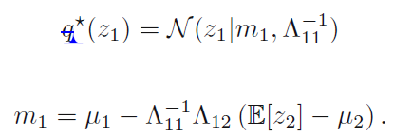
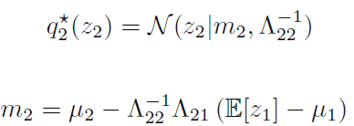


10.1 Variational Inference
Properties of factorized approximations
By way of comparison, suppose instead that we had been minimizing the reverse Kullback-Leibler divergence $KL(p||q)$
just given by the corresponding marginal distribution of $p(Z)$

Slide 7



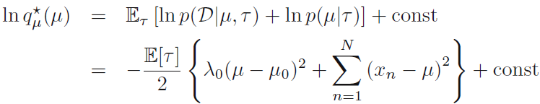
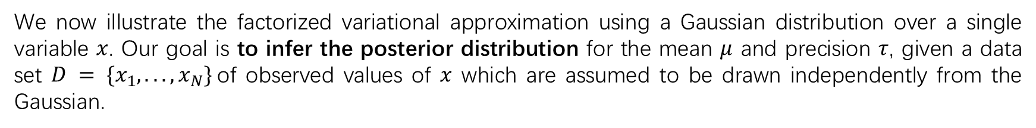
10.1 Variational Inference
Example: The univariate Gaussian
We now illustrate the factorized variational approximation using a Gaussian distribution over a single variable $x$. Our goal is to infer the posterior distribution for the mean $μ$ and precision $τ$, given a data set $D = \{x_{1}, . . . , x_{N}\}$of observed values of $x$ which are assumed to be drawn independently from the Gaussian.
The likelihood function
We now introduce conjugate prior distributions for $μ$ and $τ$ given by
we will consider a factorized variational approximation to the posterior distribution given by

Slide 8
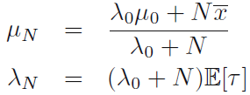

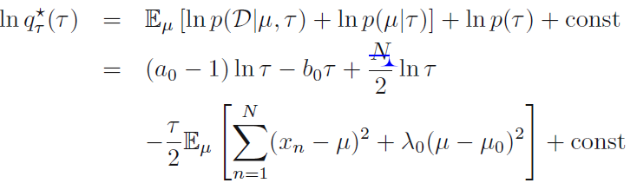
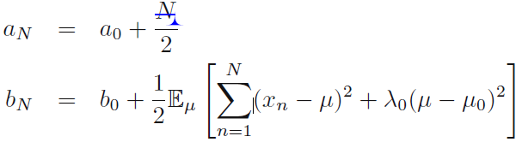

10.1 Variational Inference
Example: The univariate Gaussian

Slide 9
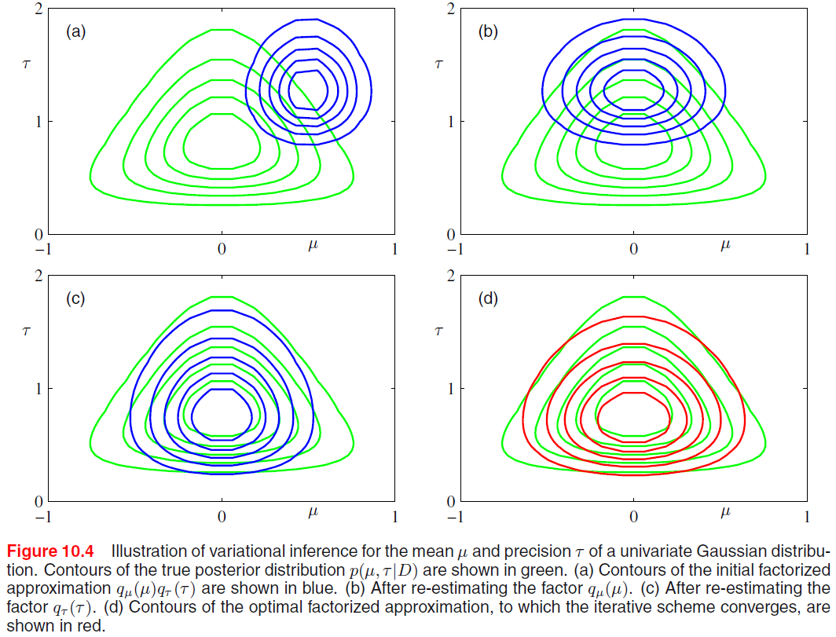
10.1 Variational Inference
Example: The univariate Gaussian

Slide 10



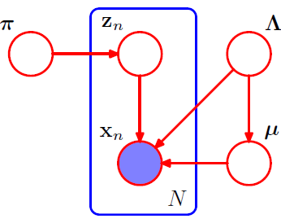
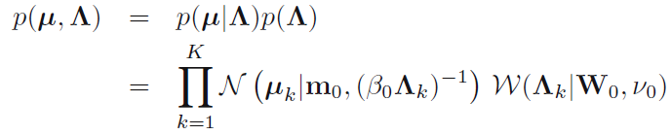


10.2 Variational Mixture of Gaussians
the conditional distribution of $Z$
$z_{n}$: 1-of-$K$ binary vector
the conditional distribution of the observed data vectors
Next we introduce priors over the parameters

Slide 11


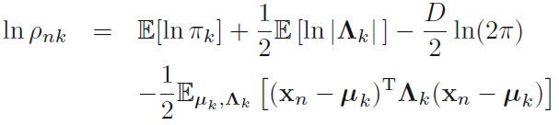
10.2 Variational Mixture of Gaussians
Variational distribution
In order to formulate a variational treatment of this model, we next write down the joint distribution of all of the random variables, which is given by
We now consider a variational distribution which factorizes between the latent variables and the parameters so that
Substituting for the two conditional distributions on the right-hand side

Slide 12
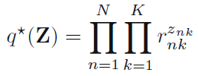
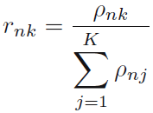
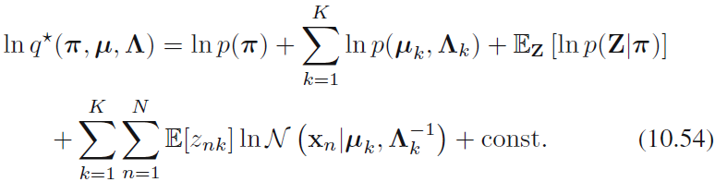





10.2 Variational Mixture of Gaussians
Variational distribution
Now let us consider the factor $q(π, μ, Λ)$ in the variational posterior distribution.
leading to the further factorization

Slide 13
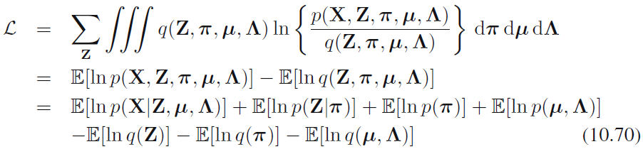
10.2 Variational Mixture of Gaussians
Variational lower bound
We can also straightforwardly evaluate the lower bound for this model. In practice, it is useful to be able to monitor the bound during the re-estimation in order to test for convergence.

Slide 14




10.2 Variational Mixture of Gaussians
Predictive density
In applications of the Bayesian mixture of Gaussians model we will often be interested in the predictive density for a new value $x$ of the observed variable.
a mixture of Student’s t-distributions

Slide 15

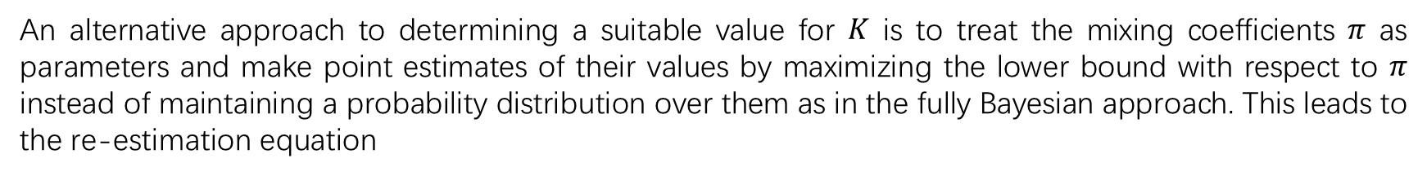
10.2 Variational Mixture of Gaussians
Determining the number of components
An alternative approach to determining a suitable value for $K$ is to treat the mixing coefficients $π$ as parameters and make point estimates of their values by maximizing the lower bound with respect to $π$ instead of maintaining a probability distribution over them as in the fully Bayesian approach. This leads to the re-estimation equation
Components that provide insufficient contribution to explaining the data will have their mixing coefficients driven to zero during the optimization. This allows us to make a single training run in which we start with a relatively large initial value of $K$, and allow surplus components to be pruned out of the model.

Slide 16




10.2 Variational Mixture of Gaussians
Induced factorizations
In deriving these variational update equations for the Gaussian mixture model, we assumed a particular factorization of the variational posterior distribution given by (10.42). However, the optimal solutions for the various factors exhibit additional factorizations. These additional factorizations are a consequence of the interaction between the assumed factorization and the conditional independence properties of the true distribution.
We partition the latent variables into three disjoint groups A, B, C and then let us suppose that we are assuming a factorization between C and the remaining latent variables, so that
whether this resulting solution will factorize between A and B, This will happen if, and only if,
Notes:
In particular, the solution for q(μ,Λ) is given by the product of an independent distribution q(μk,Λk) over each of the components k of the mixture, whereas the variational posterior distribution q(Z) over the latent variables, given by (10.48), factorizes into an independent distribution q(zn) for each observation n (note that it does not further factorize with respect to k because, for each value of n, the znk are constrained to sum to one over k).

Slide 17
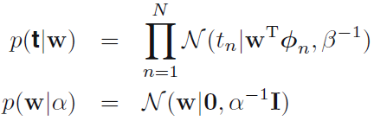






10.3 Variational Linear Regression
As a second illustration of variational inference, we return to the Bayesian linear regression model. A fully Bayesian approach would integrate over the hyperparameters as well as over the parameters.
likelihood function for $w$
the prior over $w$
prior distribution over $α$
the joint distribution of all the variables
Variational distribution
Our first goal is to find an approximation to the posterior distribution $p(w, α|t).$
Variational posterior distribution

Slide 18
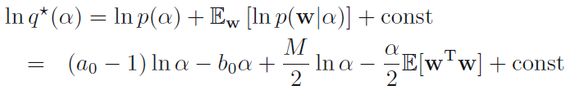

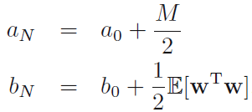
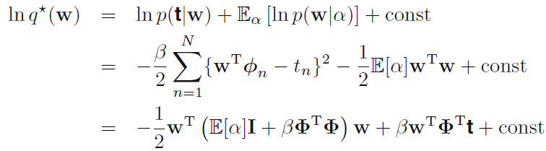

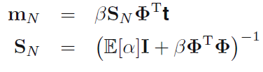

10.3 Variational Linear Regression
Consider first the distribution over $α$. Keeping only terms that have a functional dependence on $α$
Similarly

Slide 19
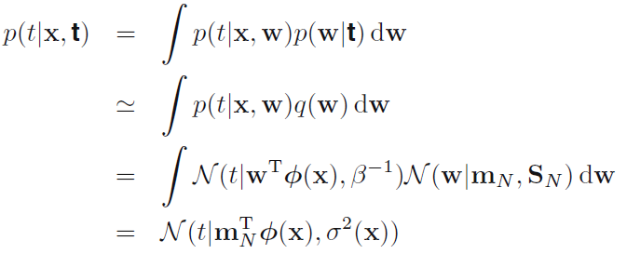

10.3 Variational Linear Regression
Predictive distribution
The predictive distribution over $t$, given a new input $x$

Slide 20
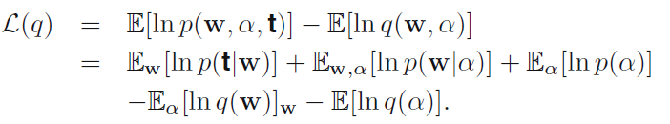
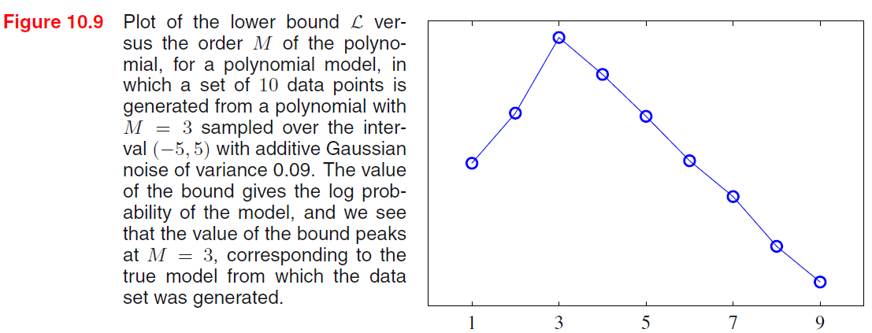
10.3 Variational Linear Regression
Lower bound
Another quantity of importance is the lower bound defined by

Slide 21


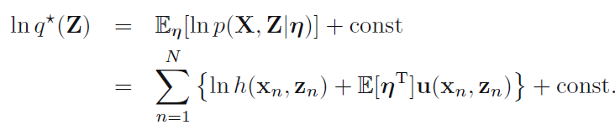



10.4 Exponential Family Distributions
Up to now we have grouped the variables in the model into observed variables and hidden variables. We now make a further distinction between latent variables, denoted $Z$, and parameters, denoted $θ$
suppose that the joint distribution of observed and latent variables is a member of the exponential family, parameterized by natural parameters $η$ so that
use a conjugate prior for $η$
Now consider the variational distribution that factorizes between the latent variables and the parameters,

Slide 22

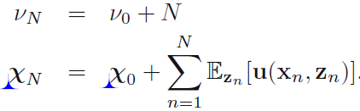
10.4 Exponential Family Distributions
Similarly, for the variational distribution over the parameters

Slide 23
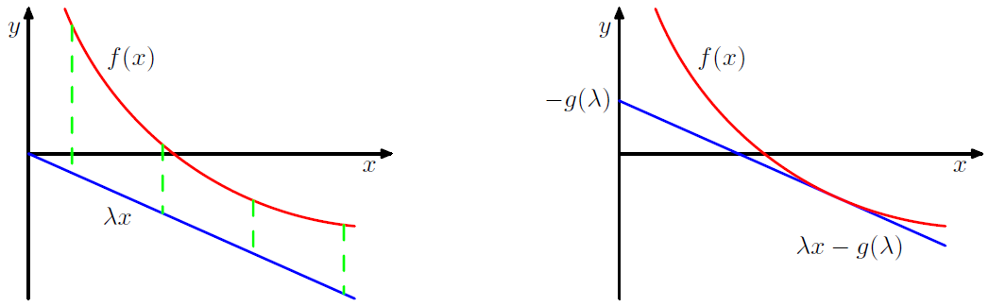
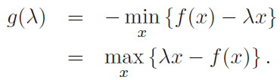

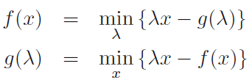
10.5 Local Variational Methods
An alternative ‘local’ approach involves finding bounds on functions over individual variables or groups of variables within a model.
For concave functions
Notes:
The variational framework discussed in Sections 10.1 and 10.2 can be considered a ‘global’ method in the sense that it directly seeks an approximation to the full posterior distribution over all random variables.

Slide 24






10.5 Local Variational Methods
An important example, which arises frequently in pattern recognition, is the logistic sigmoid function defined by
neither convex nor concave
we take the logarithm we obtain a function which is concave
the corresponding conjugate function
an upper bound on the log sigmoid
We can also obtain a lower bound on the sigmoid having the functional form of a Gaussian.
a convex function of the variable $x^{2}$

Slide 25




10.5 Local Variational Methods
conjugate function
The stationarity condition leads to
The bound on the sigmoid then becomes
(10.144)

Slide 26
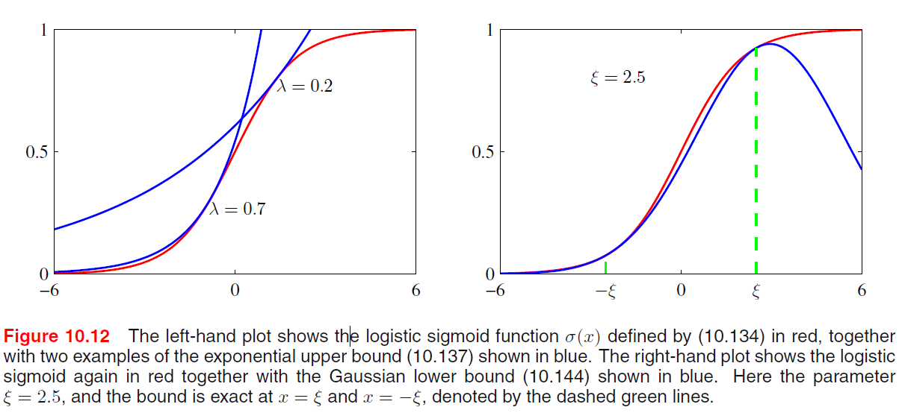
10.5 Local Variational Methods

Slide 27

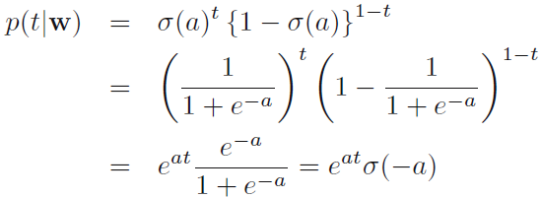


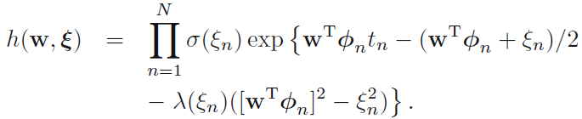


10.6 Variational Logistic Regression
We now illustrate the use of local variational methods by returning to the Bayesian logistic regression model. The greater flexibility of the variational approximation leads to improved accuracy compared to the Laplace method.
Variational posterior distribution
the marginal likelihood
the conditional distribution for $t$
The joint distribution of $t$ and $w$
(10.152)

Slide 28
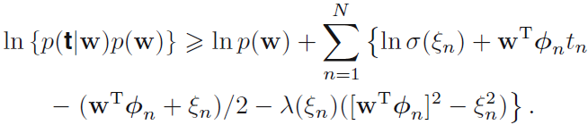
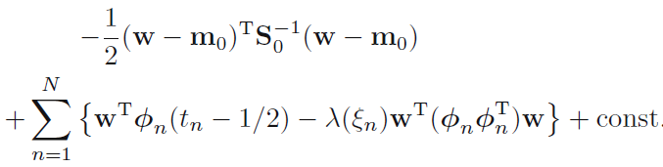

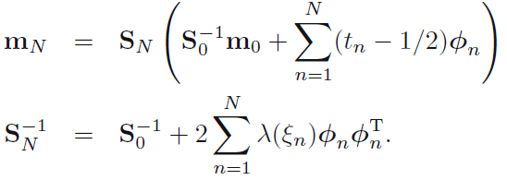


10.6 Variational Logistic Regression
Substituting for the prior $p(w)$,
Gaussian variational posterior
(10.156)
The additional flexibility provided by the variational parameters leads to improved accuracy in the approximation

Slide 29


10.6 Variational Logistic Regression
Optimizing the variational parameters
Before evaluate the predictive distribution for new data points, we need to determine the variational parameters $\{ξ_{n}\}$ by maximizing the lower bound on the marginal likelihood.
substitute the inequality (10.152) back into the marginal likelihood to give
considering the EM approach to determining the $ξ_{n}$
E step: find the posterior distribution over $w$, given by (10.156).
M step: maximize the expected complete-data log likelihood

Slide 30






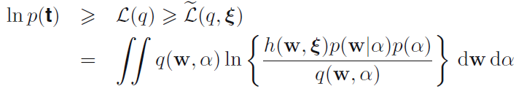

10.6 Variational Logistic Regression
Inference of hyperparameters
So far, we have treated the hyperparameter $α$ in the prior distribution as a known constant. We now extend the Bayesian logistic regression model to allow the value of this parameter to be inferred from the data set.
a conjugate hyperprior over $α$
marginal likelihood for this model
To begin with, we introduce a variational distribution $q(w, α)$
therefore apply the local variational bound to each of the logistic sigmoid factors as before

Slide 31


10.6 Variational Logistic Regression
Next we assume that the variational distribution factorizes between parameters and hyperparameters so that
Consider first the distribution $q(w).$Discarding terms that are independent of $w$, we have
Gaussian distribution
Similarly, the optimal solution for the factor $q(α)$is obtained from
Gamma distribution
Notes:
As with the variational Bayes methods discussed so far, this too is based on the minimization of a Kullback-Leibler divergence but next of the reverse form, which gives the approximation rather different properties.

